Slide 1
Instruction Guide for Opioid PPT
The Chiropractic Summit (www.chirosummit.org) has created an editable PowerPoint for you to use to educate your patients.
The format is:
A story of how opioid addiction affects lives
The statistics on opioid drug abuse, addiction and lives lost
Policy statements
The use of scientific literature to apply evidence-informed interventions as alternatives to opioids. (note: a whiplash associated disorders case was used here, but you can substitute any type of condition. Use www.tripdatabase.com to find the relevant literature to support your interventions.)
Conclusion
This is just one format to use for educating the public and your community. (note: you can also narrate by clicking on “Slide Show” and then “Record Slide Show”. You can then “Save As” a .wmv file and it will save it as a movie, and you can then post to all of your social media channels, website, email lists etc.

Slide 2
Evidence-Based Alternatives for Opioids
YOUR NAME/PRACTICE NAME

Slide 3
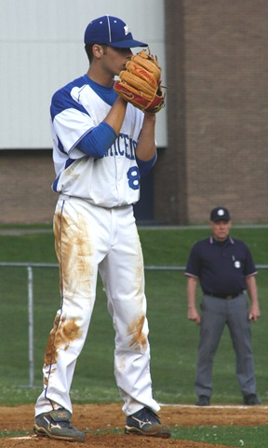
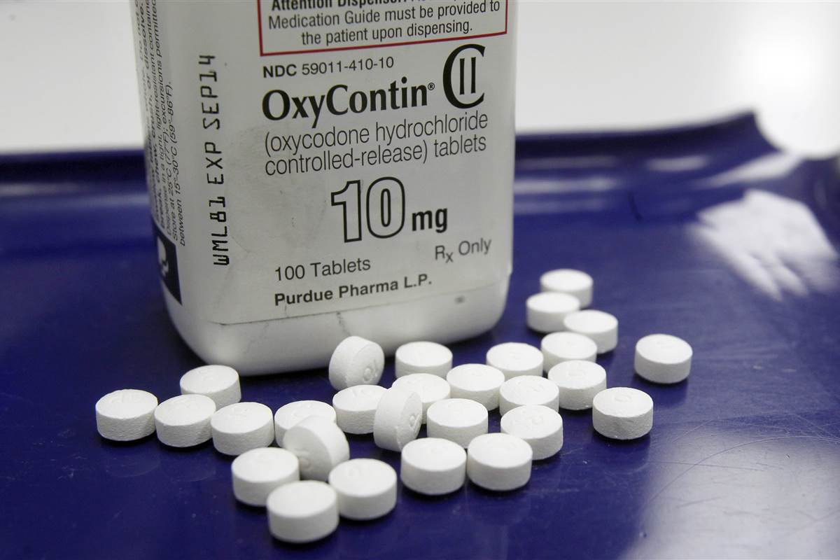
Notes:
Michael Duran- “The Einstein Jock”

Slide 4
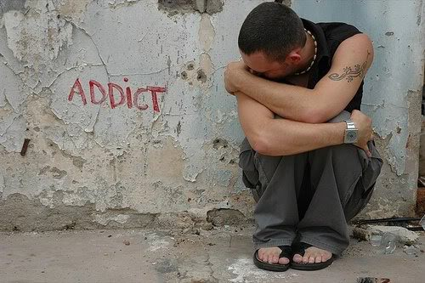
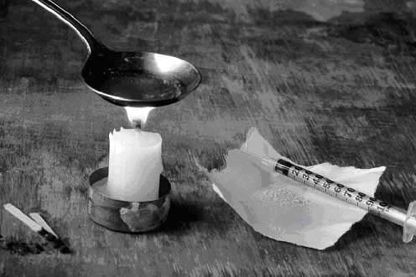

Slide 5
“Lucky to be here today at all because I have cheated death more times than I can count…”

Slide 6
In 2014, 467,000 adolescents were current nonmedical users of pain reliever, with 168,000 having an addiction to prescription pain relievers.*
2014 Journal of Child & Adolescent Substance Abuse^
High School athletes are most at risk for getting hooked on pain pills.
12% of the boys and 8% of the girls admitted to abusing painkillers including codeine and morphine.
Represents an increase over previous years.
Not typically getting their pills from a drug dealer. Instead many of them are getting the drugs after being prescribed by a doctor.
*Substance Abuse and Mental Health Services Administration, Center for Behavioral Health Statistics and Quality. (2015). Behavioral health trends in the United States: Results from the 2014 National Survey on Drug Use and Health. Rockville, MD: Substance Abuse and Mental Health Services Administration
^ http://www.tandfonline.com/doi/abs/10.1080/1067828X.2012.750974?journalCode=wcas20

Slide 7
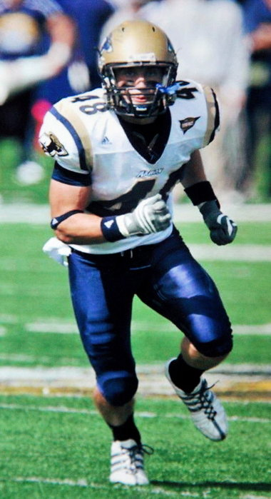
23% of athletes using pain meds w/ Rx 6% w/o Rx
Chris Jacquemain
Tyler Campbell
Notes:
Tyler Campbell Chris Jacquemain

Slide 8
$1.9M
Notes:
According to a 2016 report from the American Society of Addiction Medicine, 1.9 million have a substance use disorder involving prescription pain relievers

Slide 10
Notes:
52 deaths/day

Slide 11
Notes:
4th in the US in death rates

Slide 14
“It is the sense of the Congress that decades of experience and research have demonstrated that a fiscally responsible approach to addressing the opioid abuse epidemic and other substance abuse epidemics requires It treating such epidemics as a public health emergency emphasizing prevention, treatment, and recovery.“
Comprehensive Addiction and Recovery Act of 2016 Sec. 708

Slide 16
"Nonpharmacologic therapy and nonopioid pharmacologic therapy are preferred for chronic pain."
CDC Guideline for Prescribing Opioids for Chronic Pain
Notes:
The Policy Makers

Slide 17
" ...the possible overreliance on medications to treat pain has other unintended consequences, such as the increased prevalence of prescription medication abuse and diversion throughout the United States."
"Incorporate integrative and alternative therapeutic modalities into a patient centered plan of care."

Slide 18
" ...consumers in many insurance plans may gravitate to prescription drugs over complementary or alternative treatments, creating risks for subsequent problems with opioid dependency."
National Pain Strategy - page 34

Slide 19
The 2015/2016 Samueli Institute’s chronic pain breakthrough collaborative reported three favorable outcomes for the treatment of chronic pain patients with complementary integrative medicine.
A decrease in the number of patients relying on opioids for chronic pain
An increase in the number of patients using non-pharmacologic treatments and self-care therapies for pain
An increase in quality of life and patient function
Samueli Institute. Chronic Pain Breakthrough Collaborative. Available from: http://samueliinstitute.org/for-hospitals-and-health-care/collaboratives/chronic-pain.

