Slide 1
Whiplash-associated disorders from motor vehicle collisions affect more than 4 million Americans annually, harming their quality of life and costing an estimated $30 billion for medical/rehabilitative care per year.

Slide 4
“Interferential current as a supplement to another intervention seems to be more effective for reducing pain than a control treatment at discharge and more effective than a placebo treatment at the 3-month follow-up.”

Slide 5
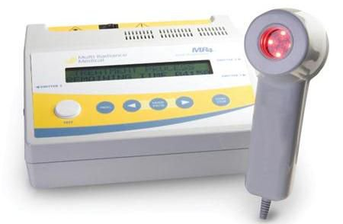

Slide 6
“Individuals with chronic neck pain who received acupuncture reported better pain relief immediately after treatment and in the short term compared to those who received sham treatments.”
“Individuals with chronic neck pain who received acupuncture reported better pain relief and improvement in disability in the short term than those who were on a wait-list.”

Slide 10
"We have heard evidence and embraced the need to reduce our reliance on prescription opioid medication for pain. But as we implement new strategies to reduce opioid prescribing, we can't lose site of the need to provide care to our patients who present with a complaint of pain. Our approach to them can't simply be about what we won't do, but has to offer a sound, evidence-based care plan laying out what we WILL do. And what we must do is provide a comprehensive, multidisciplinary plan of care that is grounded in the biopsychosocial model. Chiropractic and other complementary medicine strategies are a key element of that care plan for many patients. Integrating chiropractic care into primary medical care offers the patient the opportunity to receive comprehensive, coordinated care in their primary care medical home. Our collaboration with University of Bridgeport School of Chiropractic has allowed us to set the standard for how such integration can and should occur. Our system is better for it, and our patients are better for it.”
Daren Anderson, MD
VP/Chief Quality Officer
Community Health Center, Inc.

Slide 11
“We have found that the integration of chiropractic services enabled our patients to experience less pain and promoted healthy living. Hopefully, other community health centers in Connecticut and across the country will use our model to reduce chronic pain and improve quality of life.”
Margaret Flinter, Ph.D.
Senior Vice President and Clinical Director
Community Health Center, Inc.

Slide 13
“Exercise and mobilization programs for acute and chronic WAD had the strongest supporting evidence.”

Slide 14
“Specific strength training had high clinical relevance and led to marked prolonged relief in neck muscle pain.”

Slide 15
Conclusion
Deaths from Opioid use is on the rise
There are evidence-based, non-pharmacological approaches that yield positive patient outcomes
Care coordination among providers to identify patients appropriate for these alternatives are critical to reverse the opioid epidemic

Slide 17
For More Information:
www.ssrehab.com

